Slide 1
Introduction to DevOps

Slide 2
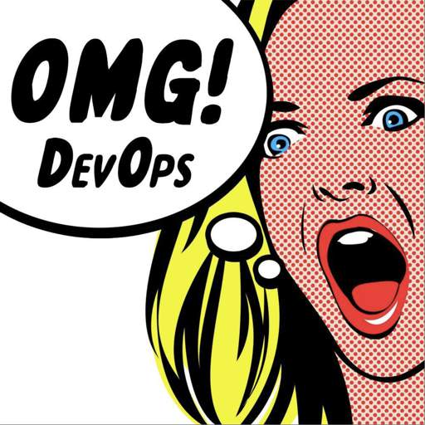
What is DevOps?

Slide 3

Anti-Pattern: “Throw it Over the Wall”
Development
Operations

Slide 4


Anti-Pattern: “DevOps Team Silo”
Development
DevOps
Operations

Slide 5
Anti-Pattern: “NoOps” Approach
Development
Dev Ops
Operations

Slide 6
Anti-Pattern: “Ops Will Handle it”
Development
Operations
Dev Ops

Slide 7
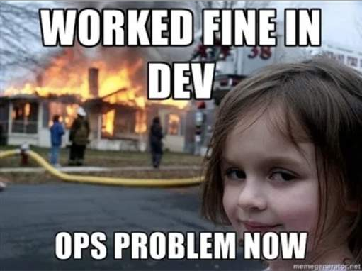
Anti-Pattern: “Ops Will Handle it”

Slide 8
Development and Operations Collaboration
Development
Operations

Slide 9
Dev and Ops Fully Shared Responsibilities
Development
Operations

Slide 10
DevOps-as-a-Service
Development
Operations
DevOps

Slide 11










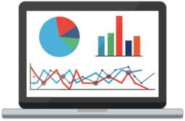



Collaboration Across Teams
Cross-Training
Support Business Agility
Breaking Down Silos
People
Process
Automation of Repetitive Tasks
“Everything” as Code
Test, Measure, and Monitor
Tools

Slide 12
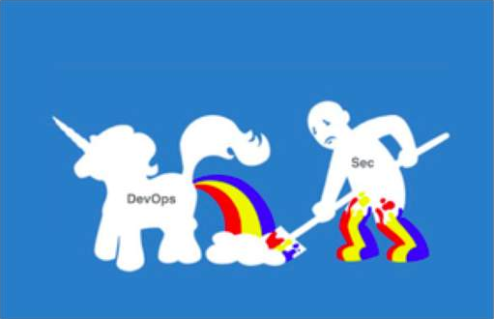
We want to turn this…

Slide 13
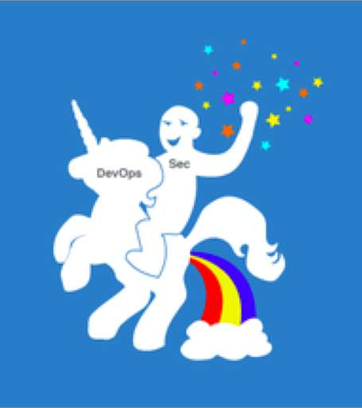
Into this!

Slide 14
“DevSecOps is the process of incorporating and enforcing meaningful security controls without slowing down deployment velocity.”

Slide 15
Enabling DevSecOps Through People

Slide 16


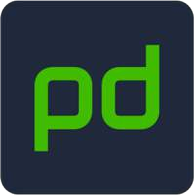
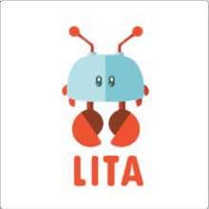

Communication and Collaboration
Critical piece to the DevOps puzzle
A culture of trust and empowerment makes for a healthy workplace
Move towards shipping software faster and more confidently
Embrace cross-team communication and training
Feedback available from each step of the pipeline
Security is a great fit in modern DevOps cultures

Slide 17
Enabling DevSecOps Through Process

Slide 18

DevSecOps Pipelines

Slide 19
DevOps Processes
Automate building the dev and production environment
Automate software testing (including security)
Automate deploying software and services
Automate monitoring and alerting
Tune your tools to become more automated and hands- off
Build the pipeline slowly and don’t fear failure!
Be careful with sensitive areas which are difficult to automate (access control, biz logic, complex actions)

Slide 20
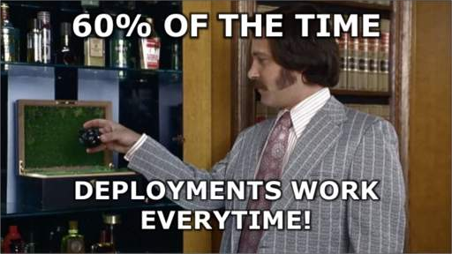

Slide 21

Key Goals of DevSecOps Pipelines
Optimize the critical resource: Security personnel
Automate things that don’t require a human brain
Drive up consistency
Increase tracking of work status
Increase flow through the system
Increase visibility and metrics
Reduce any dev team friction with application security

Slide 22





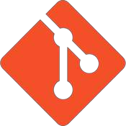
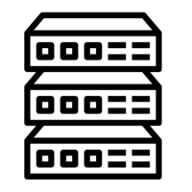








Pipeline Security
Continuous Integration
Continuous Deployment
Production
Post-deploy checks
Automated test suite
Infrastructure QA Testing (performance, load, etc.)
Build Automation
Code Committed
Repository
IaaS, PaaS, On-Prem, etc.
Configuration management, artifact creation, db migrations, etc.
Peer review
Monitoring and alerting

Slide 23

Development (Pre-Commit)
Developer laptops are the first line of defense in a DevSecOps pipeline
Moving security to the left prevents costly mistakes and vulnerabilities later
Required Git pre-commit hooks can offer a simple, effective feedback loop
–Static analysis scans in the IDE
–Peer review from security engineers
–Lightweight, threat modeling in sensitive areas
Code Committed

Slide 24
Git-Secrets
https://github.com/awslabs/git-secrets

Slide 25







Continuous Integration (Commit Stage)
Basic automated testing is performed after a commit is made
Must be quick and offer instant feedback
Key place to include security checks that run in parallel with integration tests, unit tests, etc.
Identify risk in third-party components
Incremental static security scanning
Alerting on changes to high-risk areas
Digital signatures for binaries
Automated test suite
Repository
Peer review

Slide 26
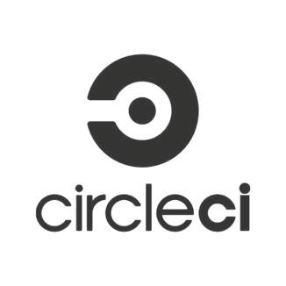




Continuous Integration (Commit Stage)
CI server may include a dedicated security worker
Third-party dependency checking performed in CI
–OWASP Dependency Check
–Node Security Project
–Bundler-Audit
–SRC:CLR
Custom alerts set on repositories and sent to “on-call” security teams
Is someone changing pw hashing algorithm?
Is a new password policy enabled?

Slide 27



Continuous Deployment (Acceptance)
Triggered by successful commit and passing build
Utilize parallel, out-of-band processes for heavyweight security tasks
IaaS and Config Management should provision latest, known-good environment state (as close to production as possible)
Security checks during acceptance:
Comprehensive fuzzing
Dynamic Scanning (DAST)
Deep static analysis
Manual security testing
Infrastructure QA Testing (performance, load, etc.)
Build Automation
Configuration management, artifact creation, db migrations, etc.

Slide 28

Continuous Deployment (Acceptance)
Zap Baseline scan incorporated into CI stage of the deployment pipeline
Runs a basic scan scan from a simple Docker run command
By default will output all results of passive scan rules
Highly configurable but still struggles in certain areas
https://github.com/zaproxy/community-scripts/tree/master/api/mass-baseline

Slide 29

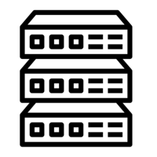
Production (Post-Deployment)
After all security checks have passed and deployment is complete
Security teams job does not stop here:
–Monitoring and Alerting
–Runtime Defense (RASP)
–Red Teaming
–Bug Bounties
–External Assessments
–Web Application Firewalls
–Vulnerability Management
Post-deploy checks
IaaS, PaaS, On-Prem, etc.

Slide 30
Thanks :)(:

Slide 31
Enabling DevSecOps Through Technology

Slide 32
Where are we going?
Infrastructure as a Service
Secrets Storage Logging and Monitoring
Containers and Microservices

Slide 33
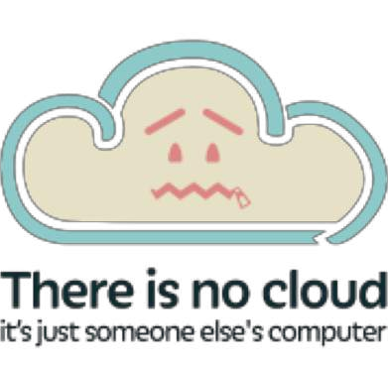
Infrastructure-as-a-Service (IaaS)
Delivery of a complete computing foundation
Servers (virtualized, physical, or “serverless”)
Network
Storage
Infrastructure is exposed to operators using a service
Programming network and infrastructure through APIs vs. buying and building physical hardware
Can be operated by a third-party, hosted in-house (K8s), or a hybrid model

Slide 34

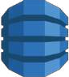

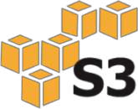
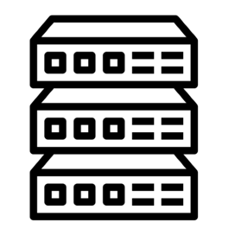
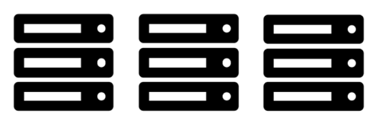
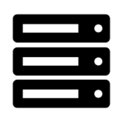
Infrastructure-as-a-Service
Managed by Ops
Auto Scaling
Amazon DynamoDB
Amazon EC2
IaaS Provider
Physical VM Hosts
Network Hardware

Slide 35

IaaS Security Considerations
“The Cloud” doesn’t do security for you – this is your responsibility
Network and Data Security
Auditing Capabilities
Compliance Requirements
– SOC, PCI, HIPAA, etc.
Encryption Capabilities
Third-Party Certificates and Audits
Secrets Storage, Built-in Security Features, etc.

Slide 36
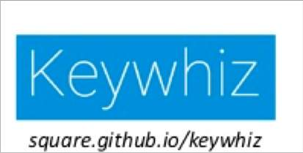

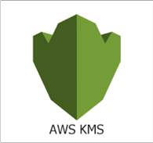

Distributing Secrets
Software systems often need access to a shared credential to operate:
Database password
Third-Party API key
Microservices
Secret management is full of opinions and could be a course itself
Many options exist – Choose your own adventure!

Slide 37
Commandments of Sane Secret Management
Secrets should not be written to disk in cleartext
Secrets should not be transmitted in cleartext
Access to secrets should be recorded
Operator access to secrets should be limited
Access control to secrets should be granular
Secrets distribution infrastructure should be mutually authenticated
Secrets should be version-controlled

Slide 38
Which is the most secure way to pass secrets to an app running in a container?
Pass secrets as an environment variable
Mount volume in container that has secrets in a file
Build the secrets into the container image
Query a ”Secrets API” over your network
Other

Slide 39
Logging, Monitoring, and Alerting
Logs are a part of daily life in the DevOps world
In security, we focus on particular logs to detect security anomalies and for forensic capabilities
A basic logging pipeline can be shared between Developers, Operations, and Security teams:
Log Aggregation: Used to ingest logs from systems, applications, network components, etc.
Long Term Storage: Filesystem which retains logs for an extended period of time. Good for forensics or breach investigation.
Short Term Storage: Filesystem or DB which stores logs to be queried quickly and easily.
Alerting: Anomaly detection system which is responsible for sending alerts to teams when a deviation occurs

Slide 40
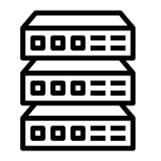
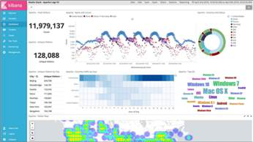
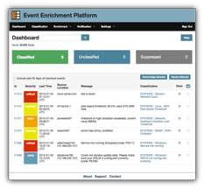

Logging and Monitoring Pipeline
Long Term Storage
IaaS
Log Aggregation
Short Term Storage
Query Interface
Anomaly
Alerting System
DevSecOps
77

Slide 41
Infrastructure as Code

Slide 42

Building Infrastructure
Is your infrastructure…
Self documenting?
Version controlled?
Capable of continuous delivery?
Integration tested?
Immutable?
Remember: ”It’s all software"

Slide 43
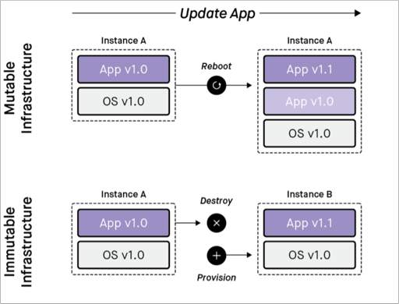
Immutable Infrastructure
“Immutable infrastructure is compromised of components which are replaced during deployment rather than being updated in place”

Slide 44

Security and Immutable Infrastructure
An immutable infrastructure starts with a “Golden Image” in a version catalog
Security teams have a central location to validate images as compliant and enforce OS hardening policies
No more guesswork what is installed Automation can flag security anomalies vs. human intervention
Tags help teams wrangle infrastructure
“Push Security to the Left”

Slide 45
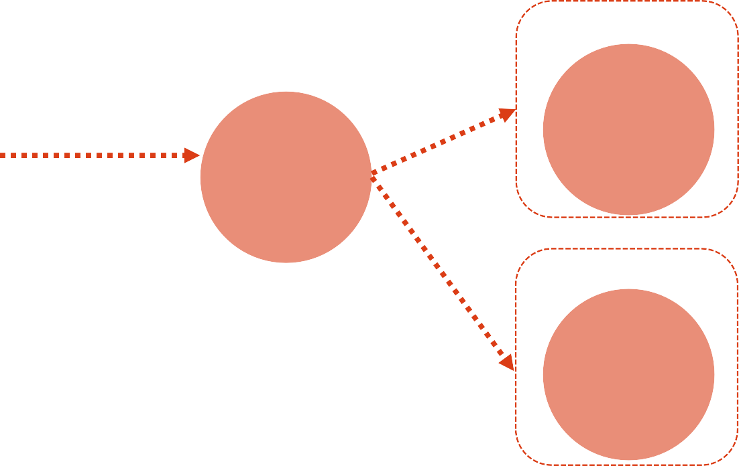



Simple Immutable Infrastructure
Instance 1
Version Catalog
Base Image
0.2
Base Image
0.2
Base OS
Instance 2
Packages
Base Image
0.2
Base Container
Instance n
Latest Code
Base Image
0.2

Slide 46
Proving Immutability
96c5…07e4bb
Instance 1
SHA1(Base_Image)
Base Image
0.2
Version Catalog
Base Image
0.2
Base OS
96c5…07e4bb
Instance 2
Packages
Base Image
0.2
Base Container
96c5…07e4bb
Instance n
Latest Code
Base Image
0.2

Slide 47




Shellshock?
Instance 1
Version Catalog
Base Image
0.2
Base Image
0.2
Base OS
Instance 2
Packages
Base Image
0.2
Base Container
Instance n
Latest Code
Base Image
0.2

Slide 48
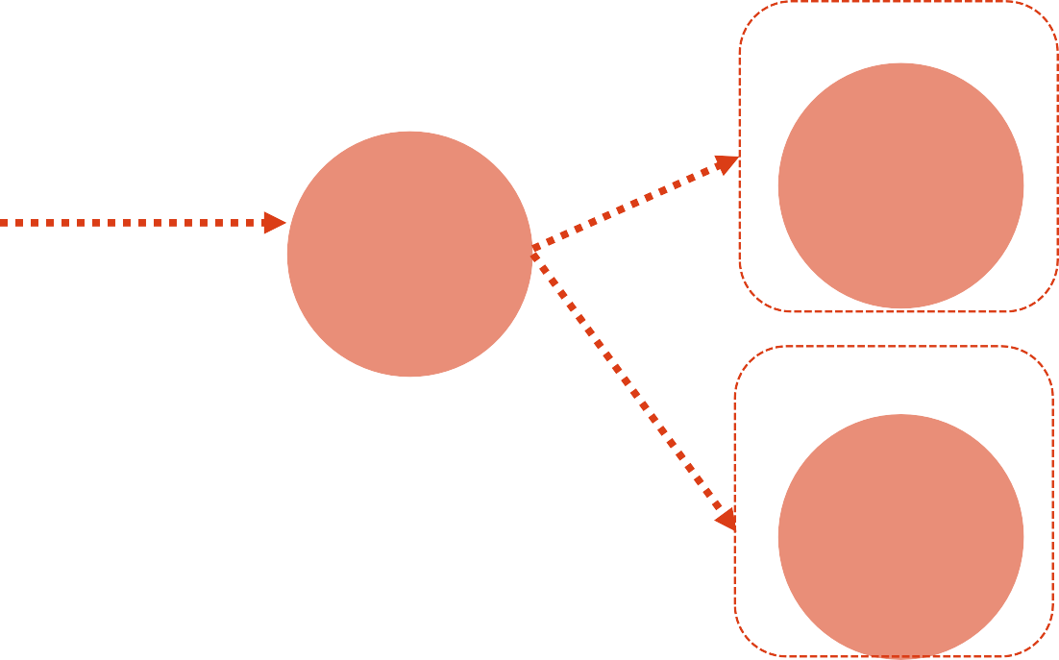

Shellshock?
Instance 1
Version Catalog
Base Image
0.3
Base Image
0.3
Base OS
Instance 2
Packages
Base Image
0.3
Base Container
Instance n
Latest Code
Base Image
0.3
Emergency Patch!

Slide 49
Security Wins
Security team now has insight into the entire system
Infrastructure is auditable and version controlled, just like source code
Patching can be applied programmatically with a high level of certainty
Alerting can be built for changes to specific areas of the infrastructure
A new firewall rule is created or deleted
Administrative user is created
New VPC rolled out
Testing can occur much earlier in the pipeline

Slide 50
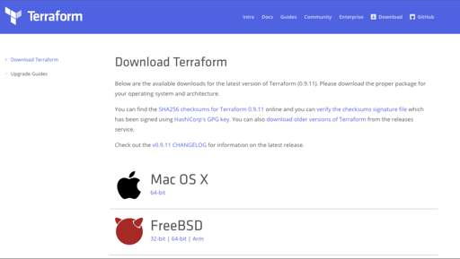
Infrastructure as Code - Terraform

Slide 51
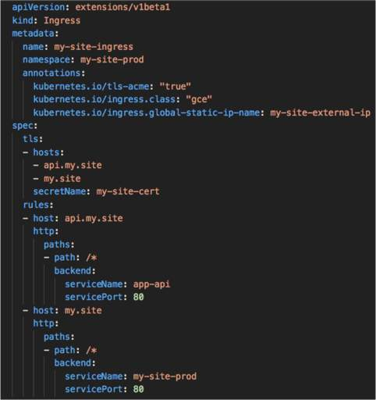
Infrastructure as Code – K8s

Slide 52
Brief Introduction to Containers

Slide 53
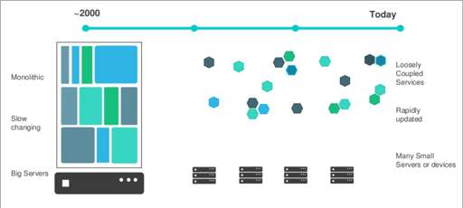
Software Deployment is Changing
Massive shift toward cloud computing
Increased demand for application and infrastructure portability across environments
Avoid vendor “lock in” when possible
Increase in microservices AKA loosely coupled services

Slide 54
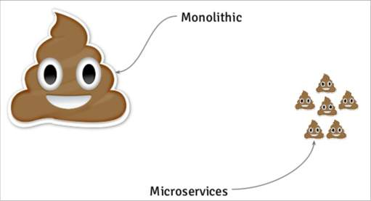
Modern Applications
Breaking monolithic applications into smaller services offers several advantages:
Scale independently
Stateless
High Availability
API-Driven
Faster iteration times

Slide 55
Issues with Modern Applications
Organizations often operate in an Ops vs. Dev vs. Sec world
Applications and microservices are written in a variety of languages and frameworks
Applications need to run on different technology stacks:
–Virtual Machines
–Windows Server
–Bare Metal Servers
–Cloud Environments
–On-Prem Environments
–Developer Laptops

Slide 56
Physical Host
Application
Operating System
Physical Server

Slide 57
One application per server
Slow deployment times
Low resource utilization
Scaling challenges
Migration challenges
$$$
Difficult to replicate locally
Application
Operating System
Physical Server

Slide 58
Physical Server
VM App Guest OS |  | VM App Guest OS |  | VM App Guest OS
Hypervisor
Host Operating System
VM

Slide 59
One physical server and multiple applications
Each application runs in a Virtual Machine
Better resource utilization
Easier to scale
VMs live in the Cloud
Still requires complete guest Operating Systems
Application portability not guaranteed
Physical Server
VM App Guest OS |  | VM App Guest OS |  | VM App Guest OS
Hypervisor
Host Operating System

Slide 60
Physical Server
Container App 1 Bins Libs |  | Container App 2 Bins Libs |  | Container App 3 Bins Libs
Docker (CRI)
Host Operating System
Container

Slide 61
Containers are an application layer construct
VMs allow us to convert one physical machine into many servers
No Operating System to boot (fast!)
Most portable out of all options
Less OS overhead using shared kernel model
Physical Server
Container App 1 Bins Libs |  | Container App 2 Bins Libs |  | Container App 3 Bins Libs
Docker (Container Runtime)
Host Operating System

Slide 62
Containers and VMs are Happy Together
Physical Server
VM 1 Container App 1 Bins/Libs Docker |  | VM 2 Container App 2 Bins/Libs Docker |  | VM 3 Container App 3 Bins/Libs Docker
Hypervisor
Host Operating System

